Slide 1
Web storage in html5
Made by: Muniba Javaid

Slide 2
introduction
With web storage, web applications can store data locally within the user's browser.
Before HTML5, application data had to be stored in cookies, included in every server request. Web storage is more secure, and large amounts of data can be stored locally, without affecting website performance.
Unlike cookies, the storage limit is far larger (at least 5MB) and information is never transferred to the server.
Web storage is per origin (per domain and protocol). All pages, from one origin, can store and access the same data.

Slide 3
Local storage
The local storage uses the localStorage object to store data for your entire website on a permanent basis.
That means the stored local data will be available on the next day, the next week, or the next year unless you remove it.
As stated earlier, the localStorage object stores the data with no expiration date.
Each piece of data is stored in a key/value pair.
. The key identifies the name of the information (like 'first_name'), and the value is the value associated with that key (say 'Peter').

Slide 4
session storage
The session storage uses the sessionStorage object to store data on a temporary basis, for a single browser window or tab.
The data disappears when session ends i.e. when the user closes that browser window or tab. As stated earlier, the localStorage object stores the data with no expiration date.
The sessionStorage object work in the same way as localStorage except that it stores the data only for one session i.e. the data remains until the user closes that window or tab.

Slide 5
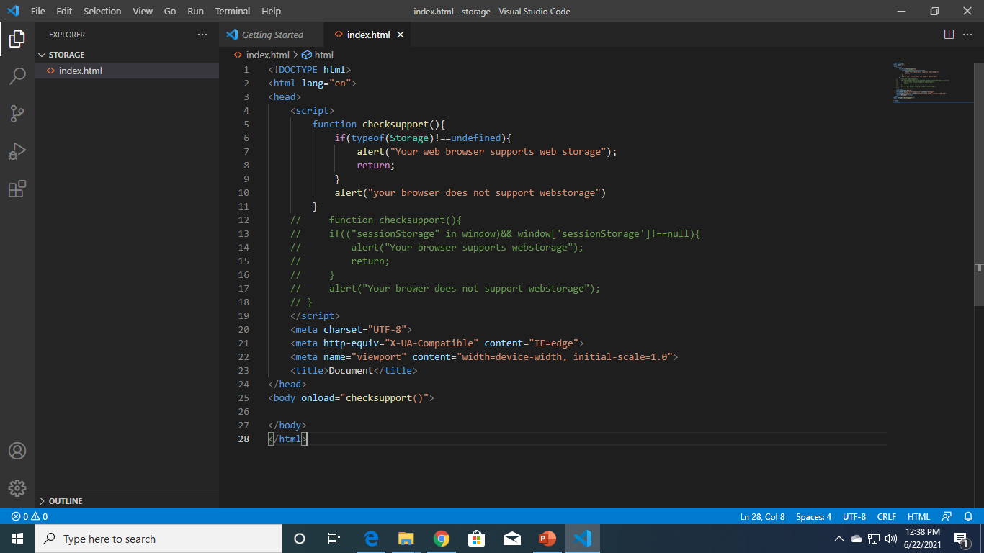
Example1(to check webstorage support)

Slide 6
Storing and retrieving data
The setItem() and getItem() methods are used to store and retrieve data from session and local storage respectively.
The syntax to use the setItem() and getItem() method is as follows:
To assign data
sessionStorage.setItem(key,value);
Where, key: is the named key to refer to the data
value: is the data to be stored.
To retrieve data
var item= sessionStorage.getItem(key);
Where, key: is the named key to refer to the data
item: is the variable into which the data will be saved

Slide 7
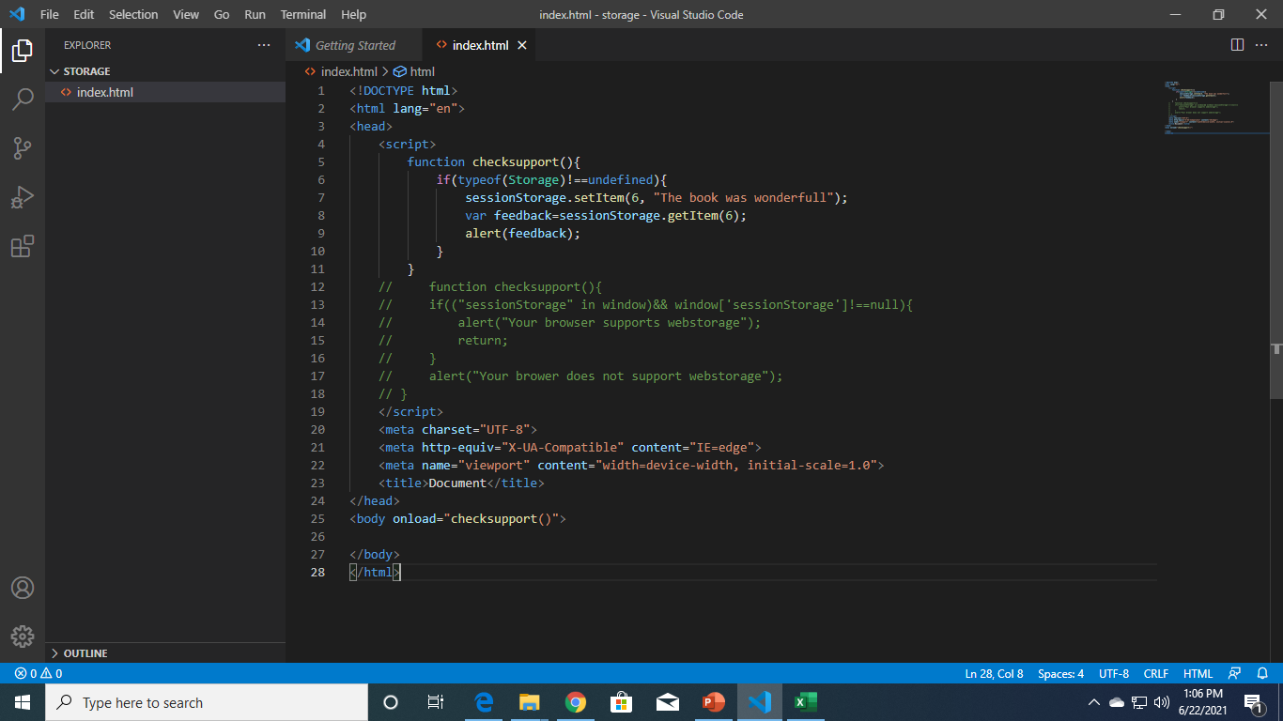
Example 2

Slide 8
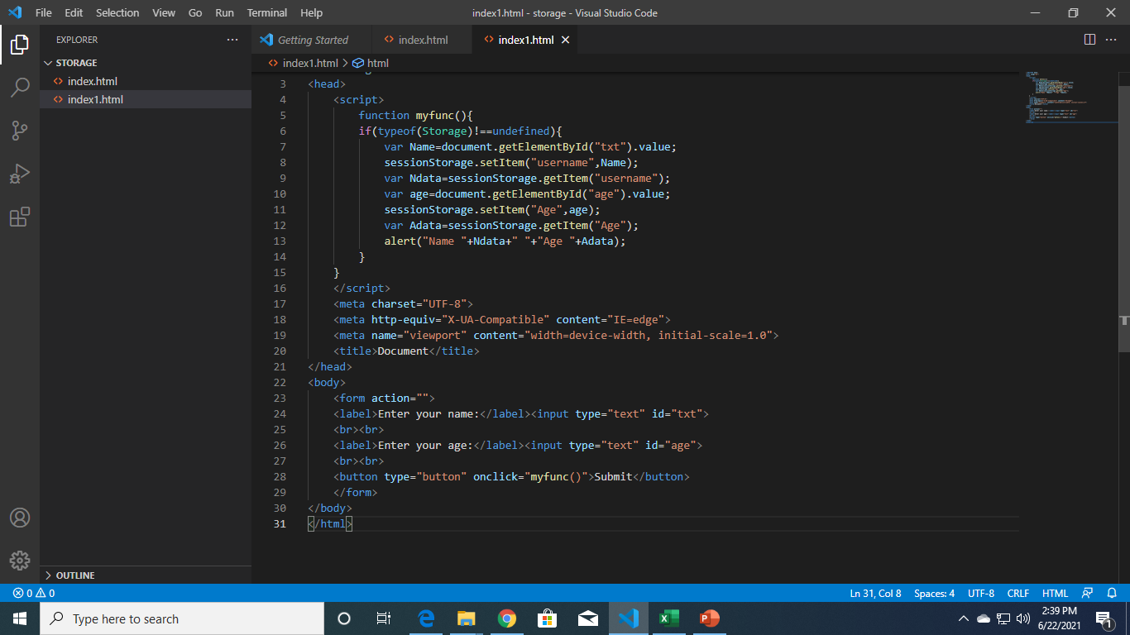
Example 3

